Slide 1

MiYE – Mud in Your Eye
Resort Spa Reservation Application

Slide 2
Application Features
Login - User Authentication & Authorization
Management – Service & Customer
Billing – View & Print Service Reports
Reservations – Create, Cancel & View

Slide 3
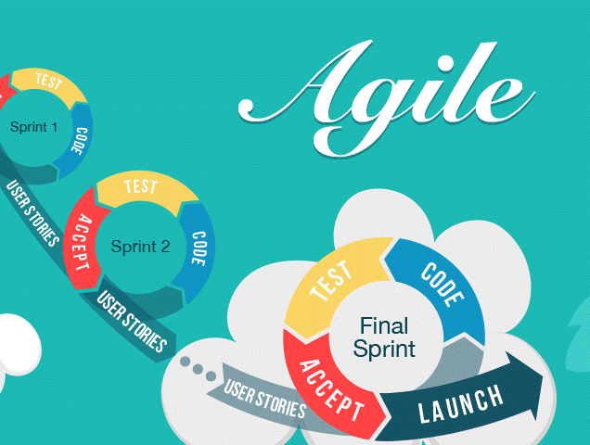
Agile Software Development Process
User Stories
Planning Poker (time estimates)
Communication Paths
Multiple Iterations
Testing
Milestone Deliverable

Slide 4


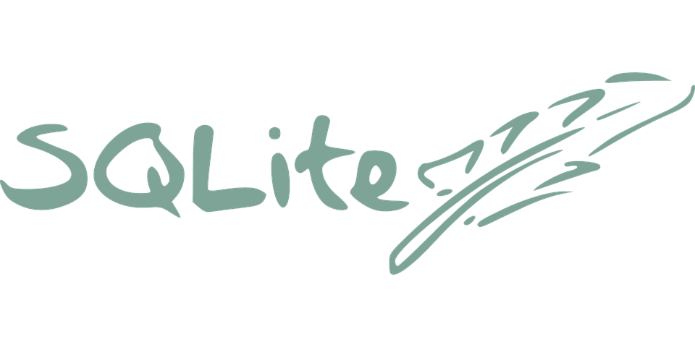
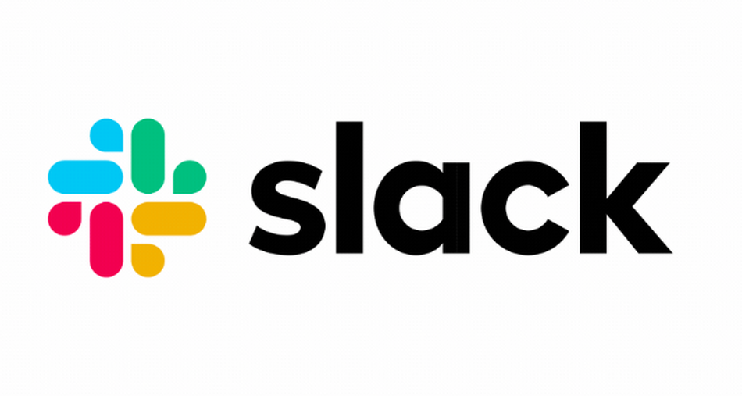



Tools & Applications
Language: Python 3
Framework: Django
Frontend: jquery/html/ES6
Database: SQLite 3
GitHub
Slack
Trello
Zoom
OneDrive

Slide 5
Established clear communication paths
Define best practices and conventions
GitHub Slack Trello Email
Pilone & Miles
Create a meaningful definition of done and good enough
Team Experience
Reviewed Timeline
Managed Expectations
Getting Our Process Started

Slide 6
Next...
Set up our environment, tools, and applications
Avoid having multiple document management systems
Prepared the codebase and project structure

Slide 7
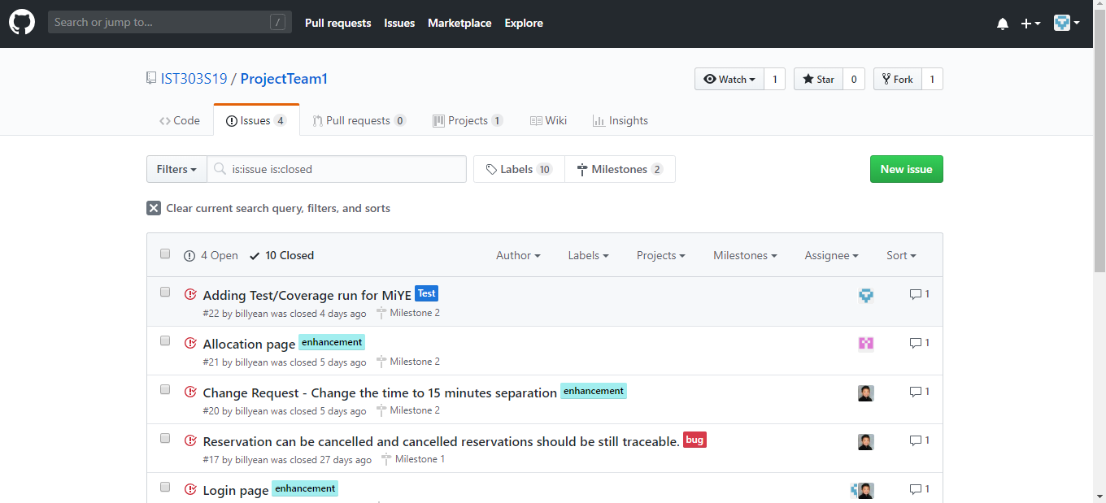
Git Hub Repository

Slide 8
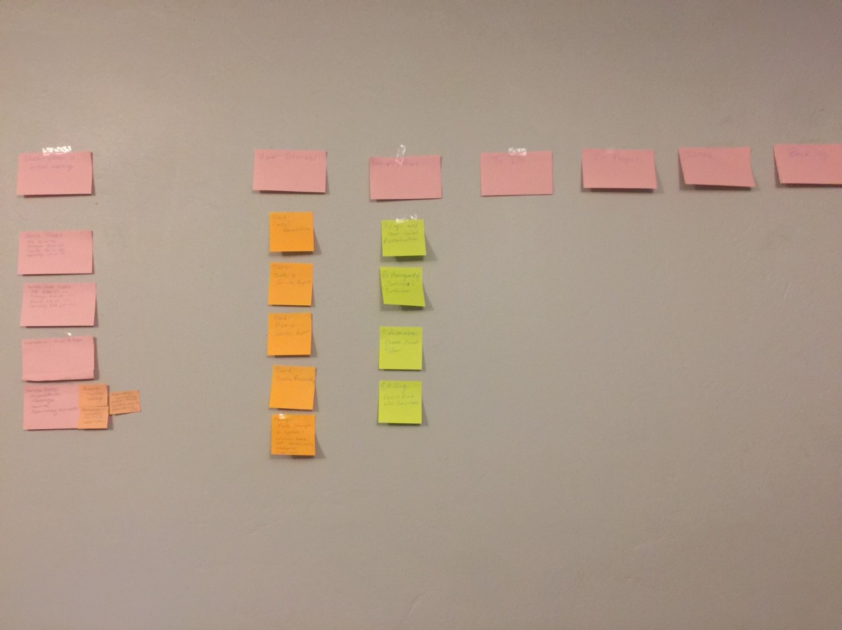
Big Board version 1

Slide 9
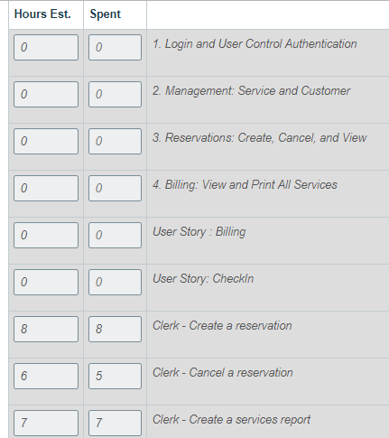
Time Estimates

Slide 10

What We Learned in Milestone 1
A "Sticky Note" Big Board is difficult to use when the team is not in one location.
Planning Poker takes practice within a team with highly experienaced to novice developers.
Definitions help!!!
Effort vs Time Estimate
Hours of work vs Number of days
To manage team expectations not just customer expectations.
Increase Communication.

Slide 11
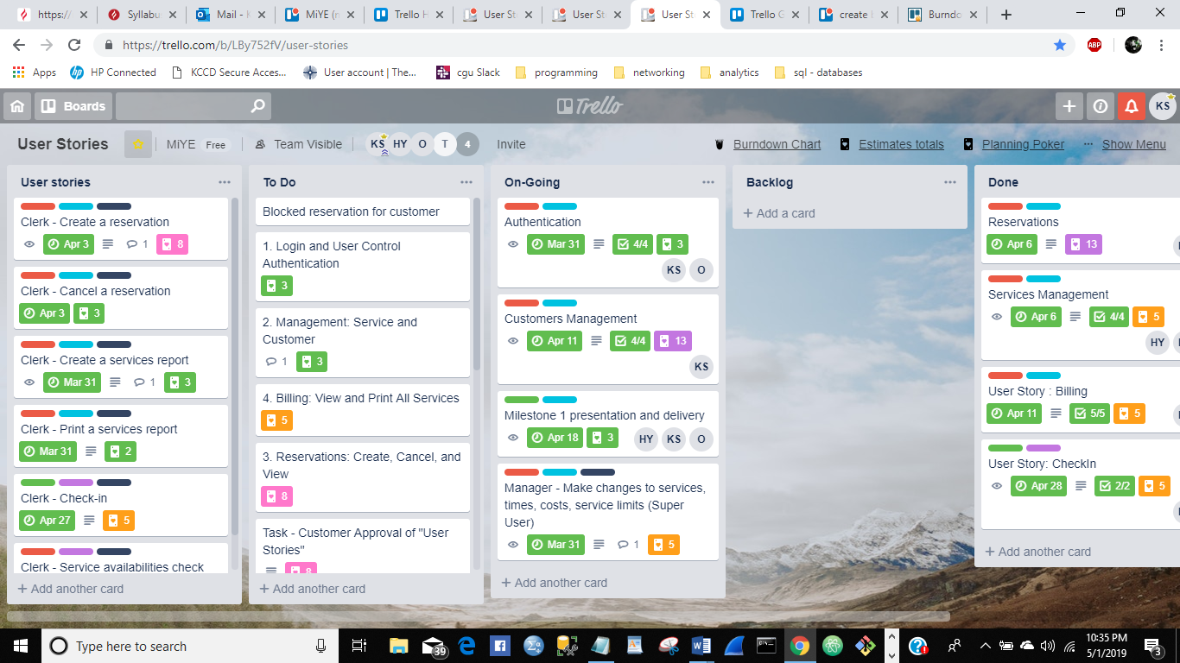
Changes in Our Process: Moved "Sticky Note" Big Board to Trello

Slide 12
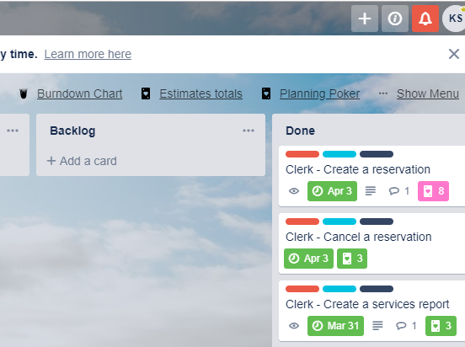
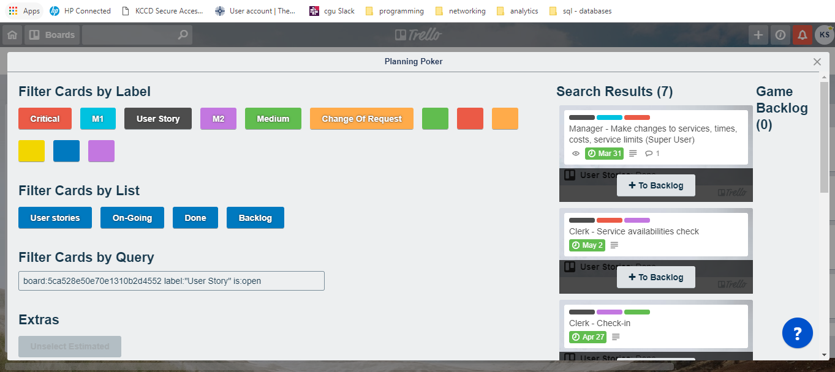
Changes in Our Process: Used Trello "Power Up" for Planning Poker

Slide 13
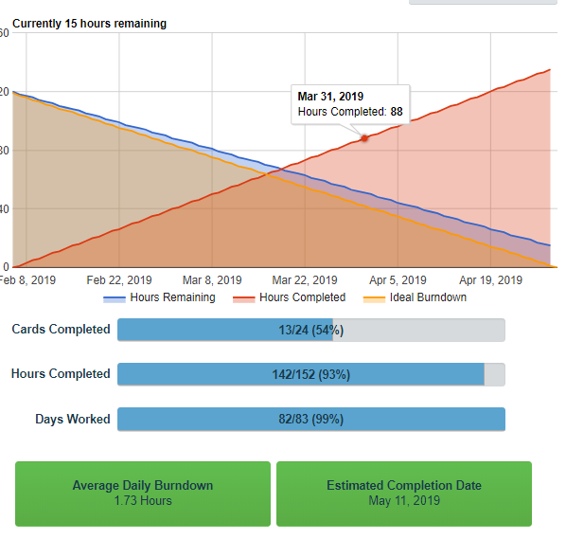
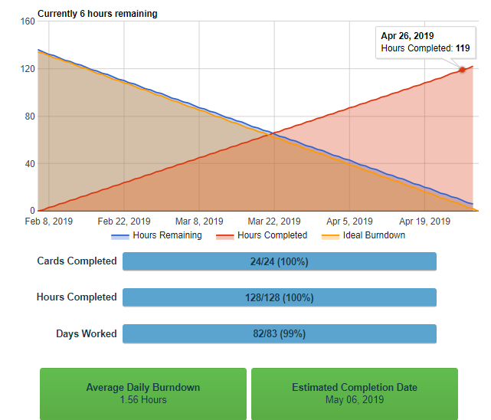
Changes in Our Process: Used Trello "Power Up" for Burn Down Chart

Slide 14
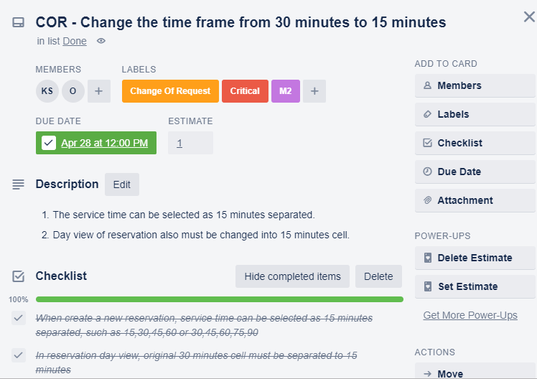
Changes to User Stories and Software Requirements
Update Trello Cards
Update Time and Effort Estimates
Assigned Tasks
Completed the Updates
Tested

Slide 15
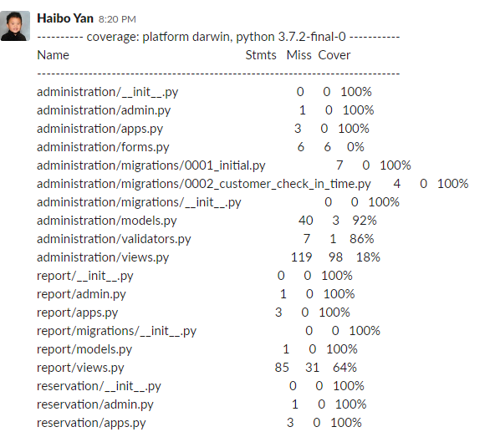
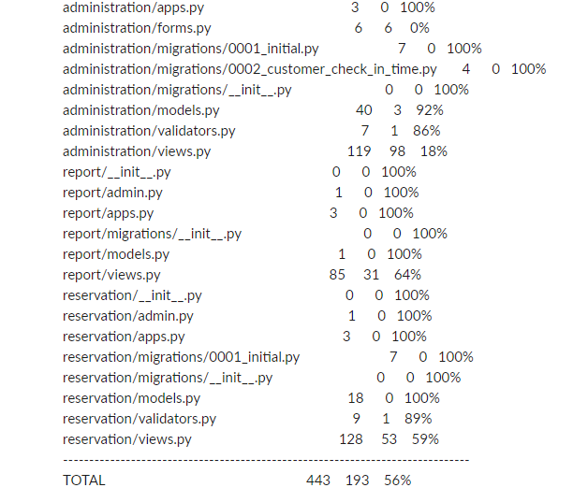
Testing: From Unit to System

Slide 16
Unit Test
Test framework: django-pytest
Command: python –m pytest

Slide 17
More Lessons Learned
Trello Power Ups were not intuitive to use and were not free.
With our CGU Microsoft Account we can use Azure Dev Ops for free which includes estimates, burn down charts, iterations (sprints), and milestones.
Planningpoker.com is free to use but is focused on Scrum.
Communication is still KEY!!!!!!

Slide 18

Live Demonstration

Slide 19
Q&A
Karen Snow - Business Design, Programmer
Okechukwu Ugwuanyi - UI Design, Programmer
Haibo Yan - System Design, Programmer

